Slide 1
Lecture 3 - Antenna Parameters
Jatinder Singh
Assistant Professor
ECE Department
UIET, PU Chandigarh

Slide 2

Radiation Intensity
Aside on Solid Angles
surface area = r ²
ρ
θ = 1.0 rad
arc length = ρ
r
Ω = 1.0 sr
total circumfrance = 2π radians
total surface area = S = 4π r ² = Ω r ²
o
Ω = ^{So} sr
_{r} 2
ds = r ² sin(θ ) dθ dφ
infinitesimal area of surface of sphere
dΩ = ^{ds} = sin(θ ) dθ dφ
_{r} 2

Slide 3
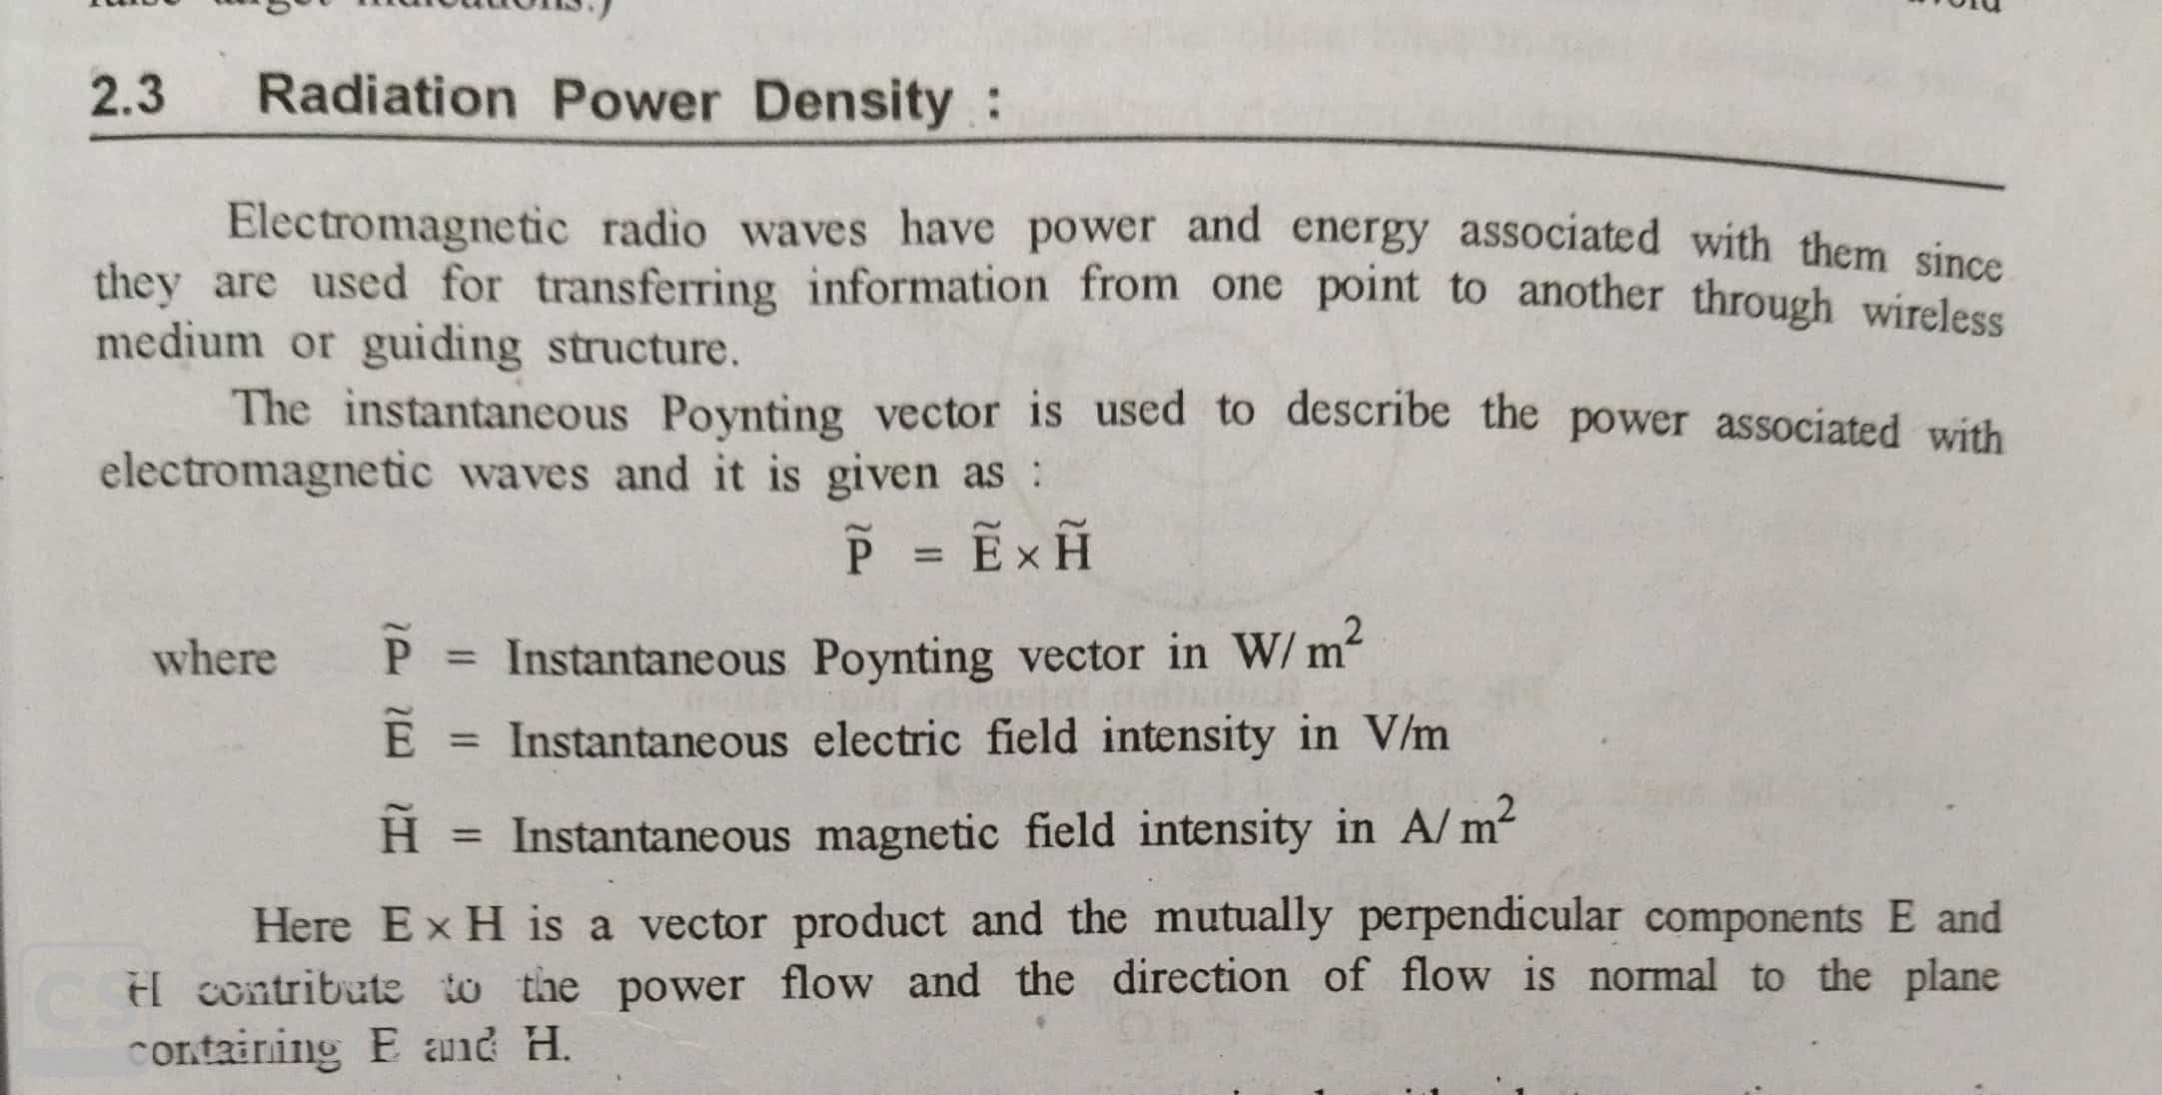
Radiation Power Density

Slide 4
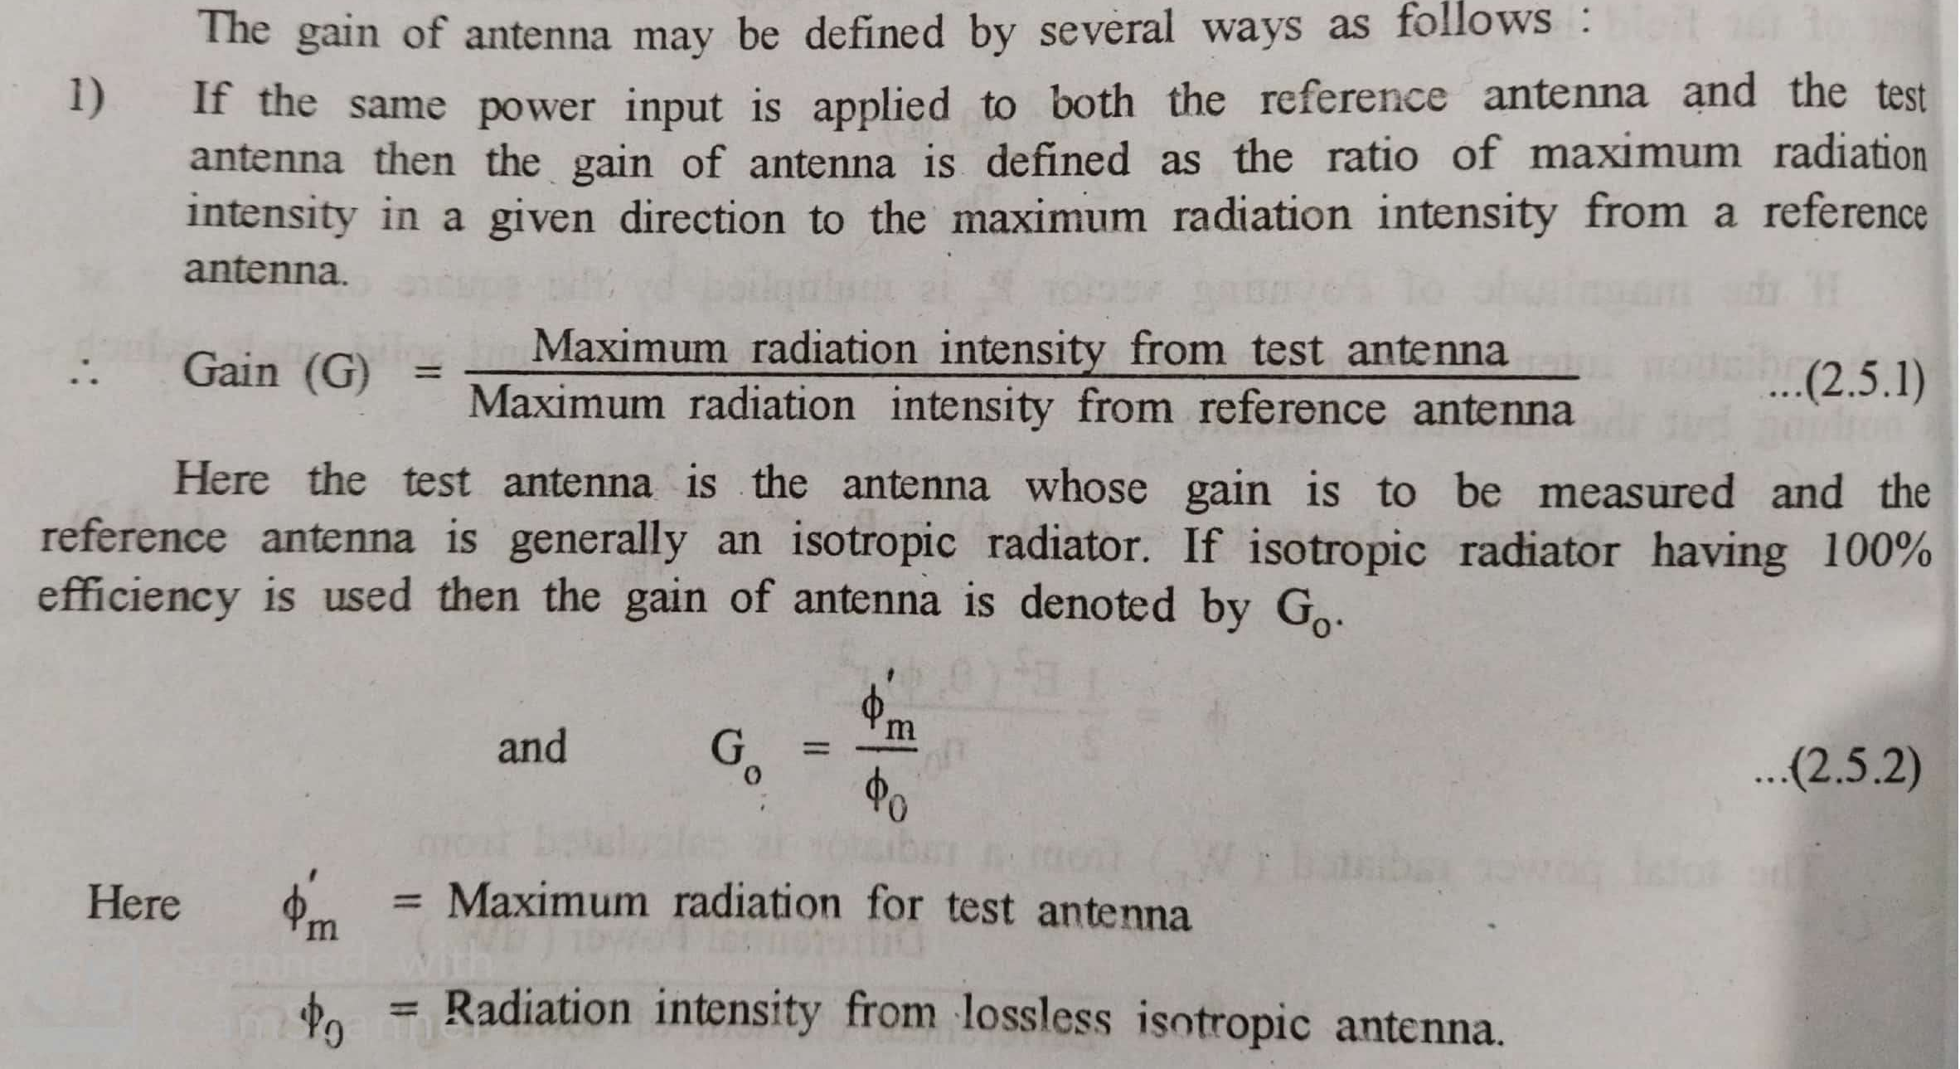
Antenna Gain

Slide 5
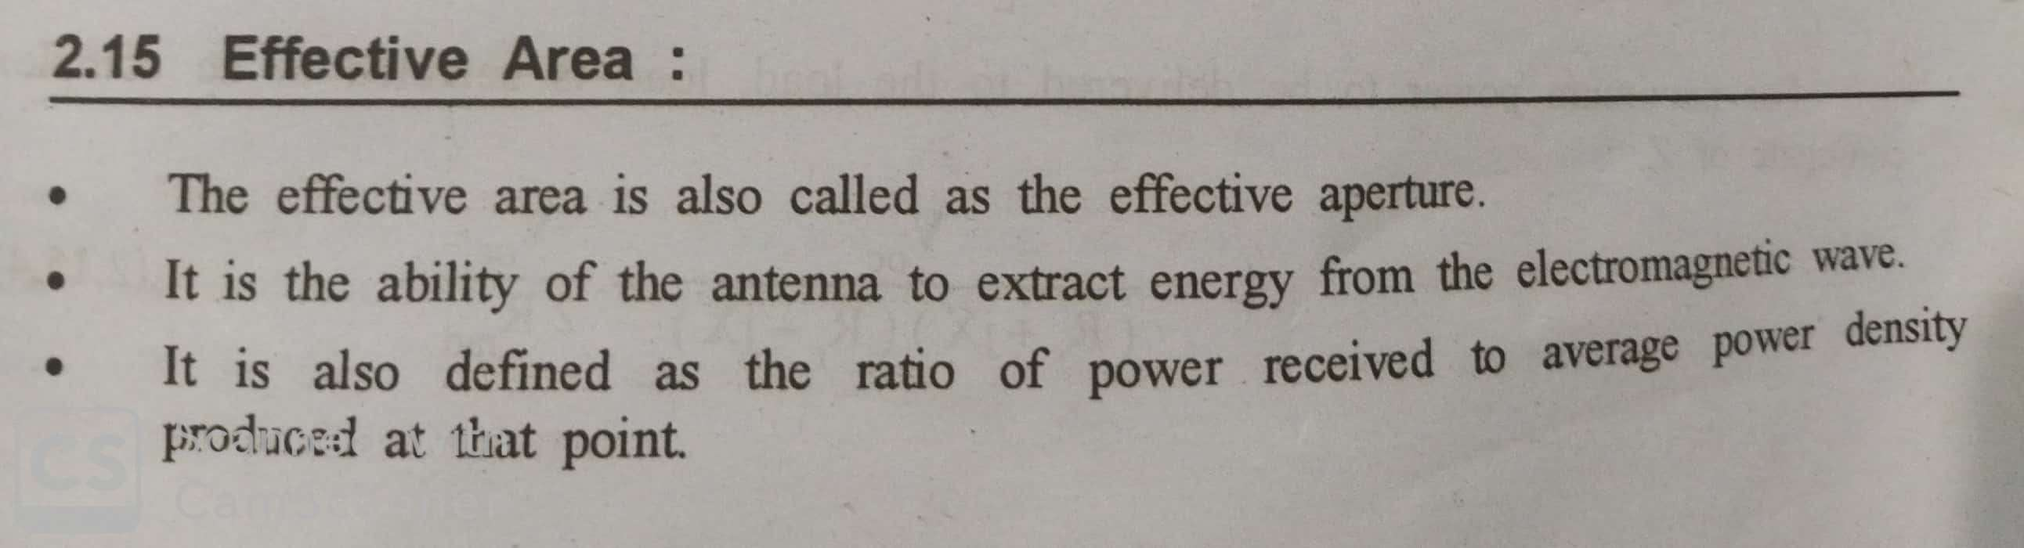
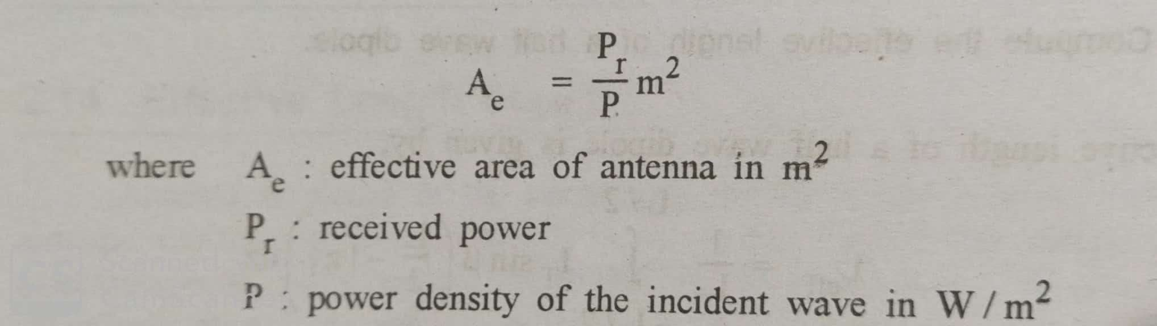
Effective Area

Slide 6
Antenna Gain
Relationship between antenna gain and effective area
G = antenna gain
A_{e} = effective area
f = carrier frequency
c = speed of light (» 3 ´ 10⁸ m/s)
λ = carrier wavelength

Slide 7
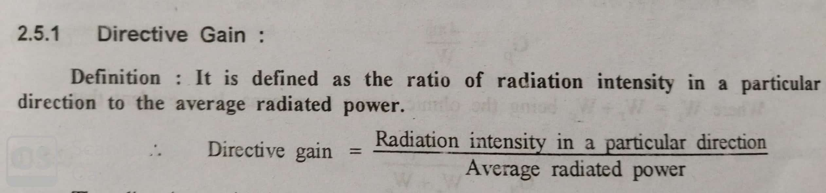
Directive Gain

Slide 8
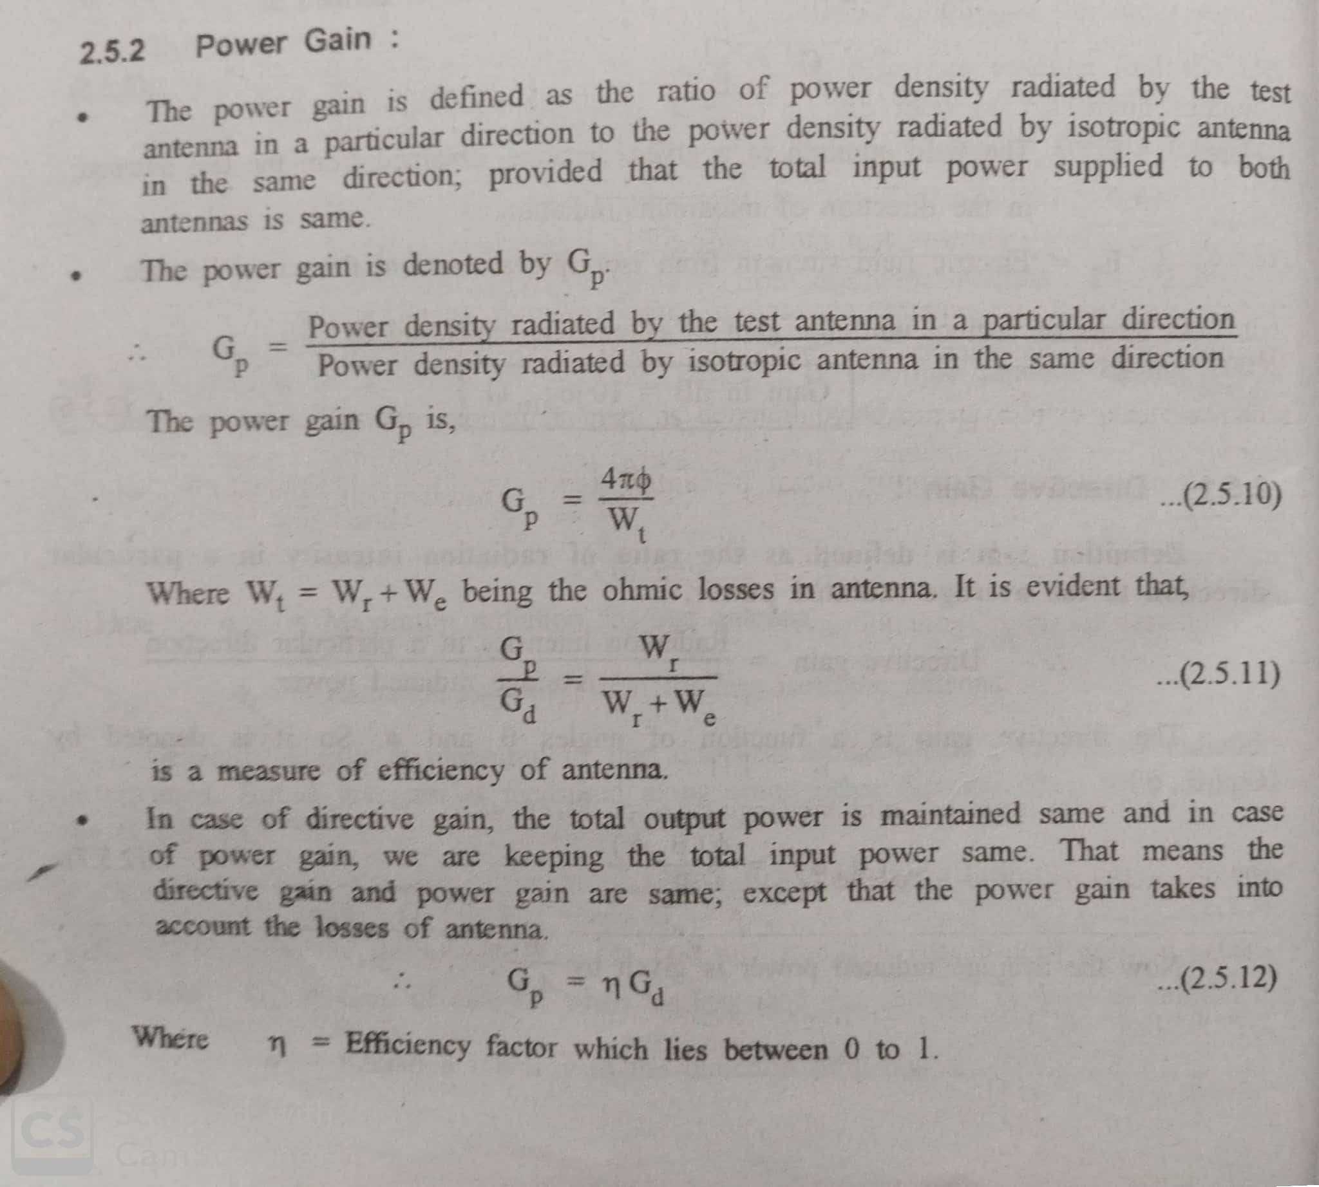
Power Gain

Slide 9
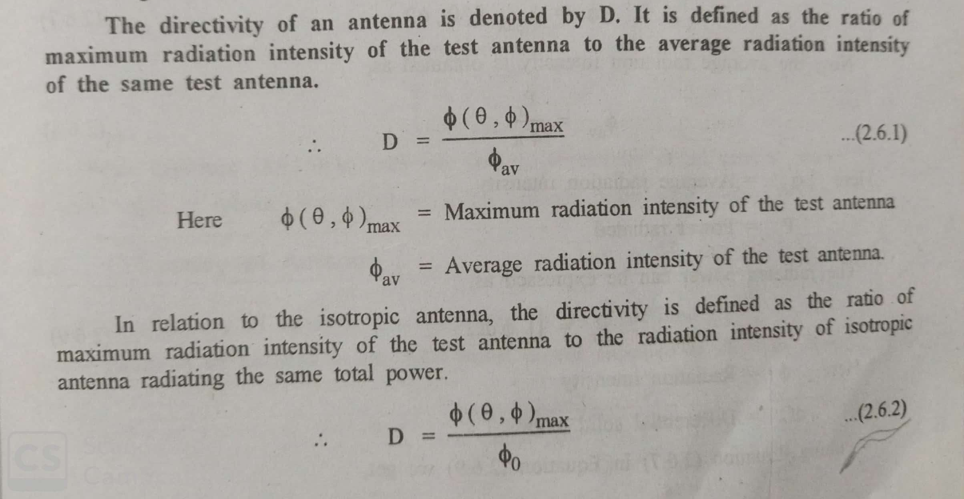
Directivity

Slide 10
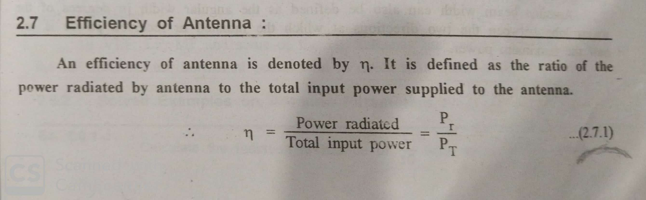
Efficiency

Slide 11
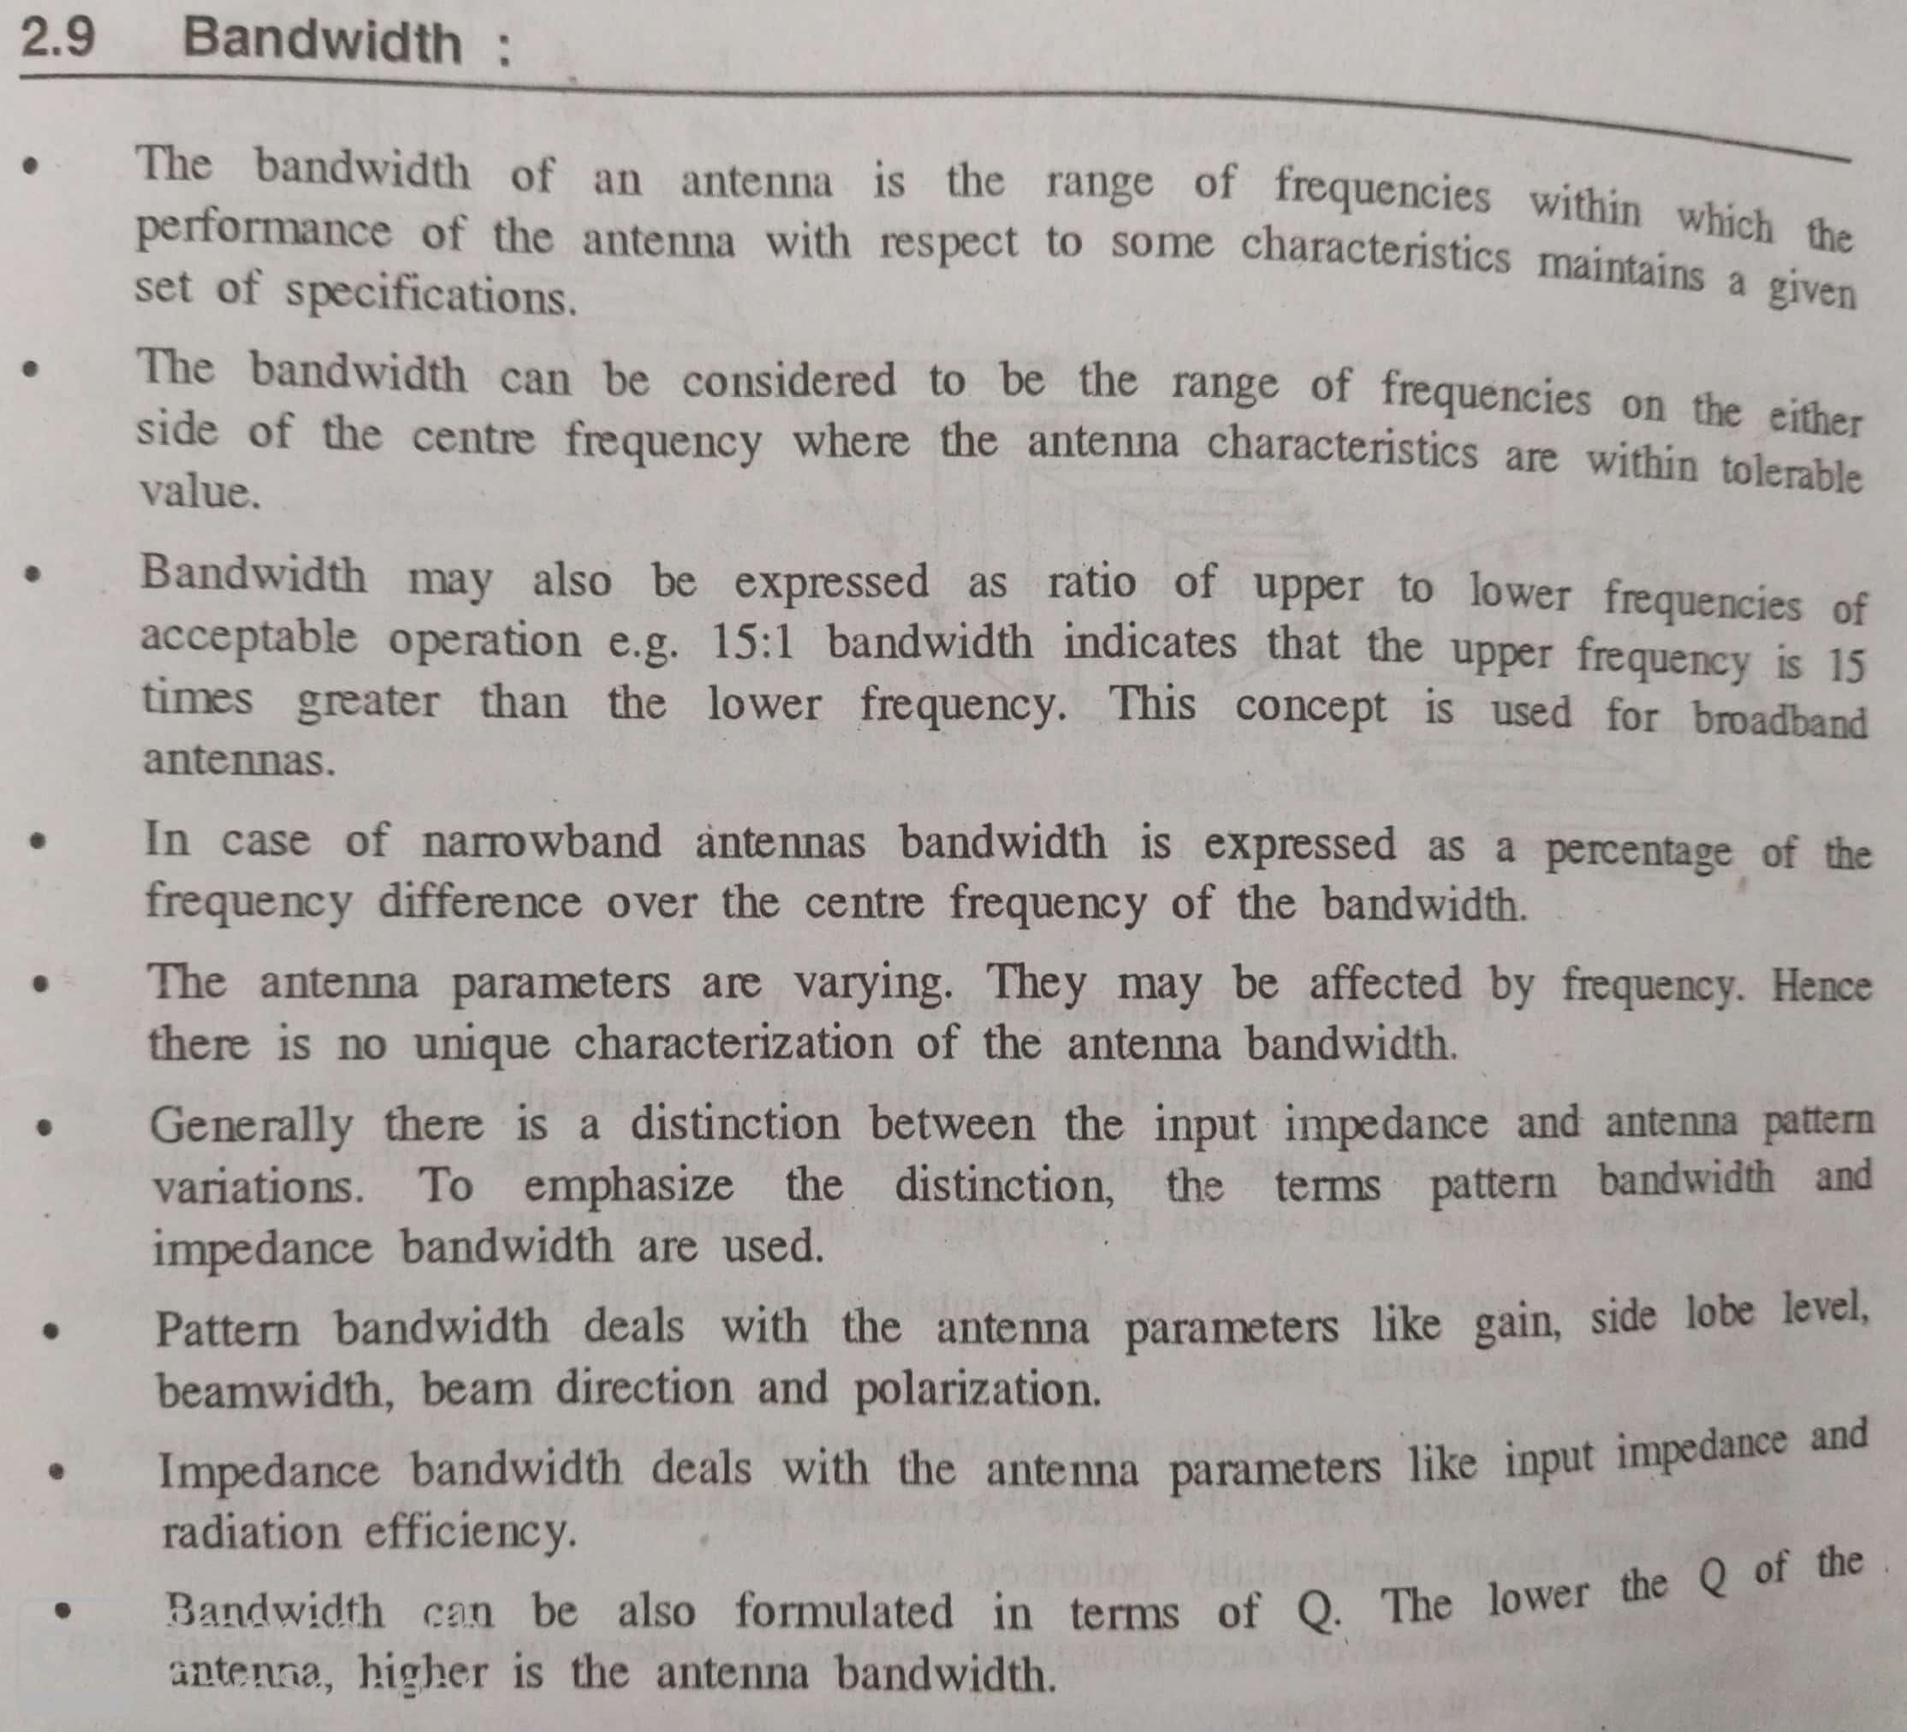
Bandwidth

Slide 12
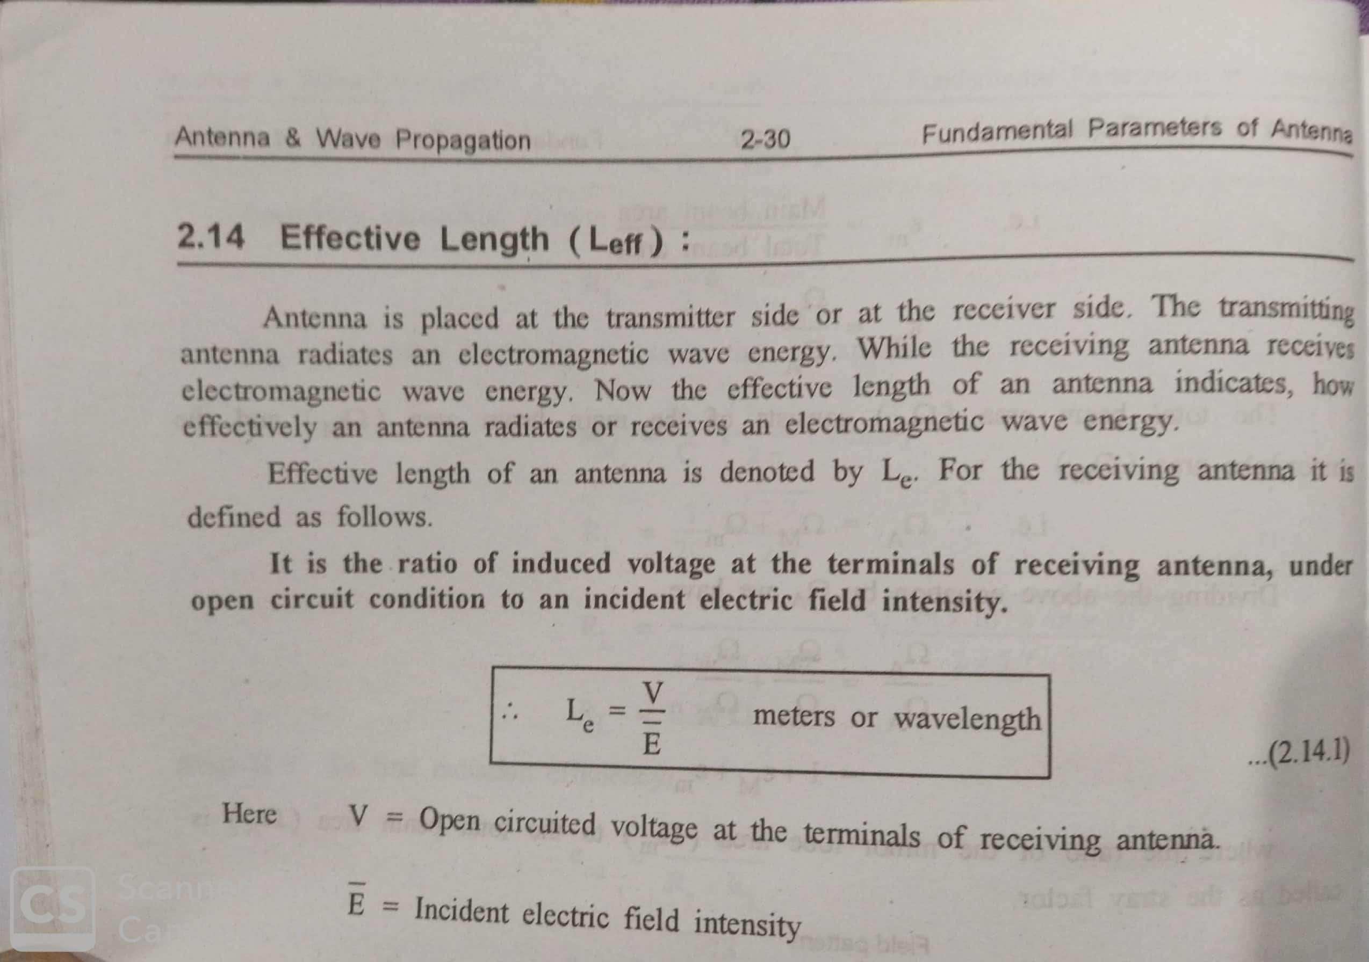
Effective Length

Slide 13


Two fields regions:
ºNear field or Fresnel region: The region within the radius of the smallest sphere which completely encloses the antenna is called Fresnel region.
ºFar Field or Fraunhofer region: The region beyond Fresnel region is called Fraunhofer region

